Slide 1
Adapter Pattern
Sai Sandeep -61
Prudhvi Sai Suggala-51
Hemanth Kumar Reddy-11
Snehal Vantasala-55

Slide 2
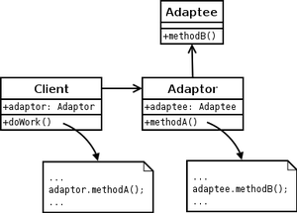
Adapter Pattern:
In software engineering, the adapter pattern is a software design pattern that allows the interface of an existing class to be used as another interface. It is often used to make existing classes work with others without modifying their source code.

Slide 3
Reuse has always been painful and elusive. One reason has been the tribulation of designing something new, while reusing something old. There is always something not quite right between the old and the new. It may be physical dimensions or misalignment. It may be timing or synchronization. It may be unfortunate assumptions or competing standards.
It is like the problem of inserting a new three-prong electrical plug in an old two-prong wall outlet – some kind of adapter or intermediary is necessary.
Adapter is about creating an intermediary abstraction that translates, or maps, the old component to the new system. Clients call methods on the Adapter object which redirects them into calls to the legacy component. This strategy can be implemented either with inheritance or with aggregation.
Adapter functions as a wrapper or modifier of an existing class. It provides a different or translated view of that class

Slide 4
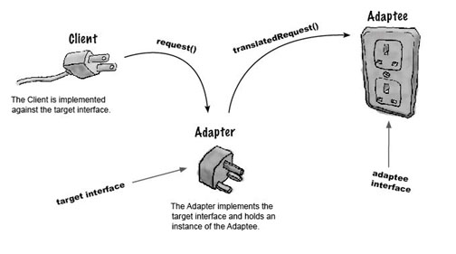
A simple example of adapter

Slide 5
Program
Let us consider an example in case of a war, We have
Enemy war Tank this can fire using a weapon and cause some damage, move forward and has a driver in it(Client).
A robot, to smash the tanks, this can walk forward, and react to a human(Adaptee).

Slide 6
Enemy Attacker(Target)
public interface EnemyAttacker
{
public void fireWeapon();
public void driveForward();
public void assignDriver(String driverName);
}

Slide 7
Enemy Tank
import java.util.Random;
public class EnemyTank implements EnemyAttacker{
Random generator = new Random();
public void fireWeapon() {
int attackDamage = generator.nextInt(10) + 1;
System.out.println("Enemy Tank Does " + attackDamage + " Damage");}
public void driveForward() {
int movement = generator.nextInt(5) + 1;
System.out.println("Enemy Tank moves " + movement + " spaces");
} public void assignDriver(String driverName) {
System.out.println(driverName + " is driving the tank");
}
}

Slide 8
Enemy Robot(Adaptee)
import java.util.Random;
public class EnemyRobot{
Random generator = new Random();
public void smashWithHands() {
int attackDamage = generator.nextInt(10) + 1;
System.out.println("Enemy Robot Causes " + attackDamage + " Damage With Its Hands");}
public void walkForward() {
int movement = generator.nextInt(5) + 1;
System.out.println("Enemy Robot Walks Forward " + movement + " spaces");}
public void reactToHuman(String driverName) {
System.out.println("Enemy Robot Tramps on " + driverName); }}

Slide 9
Enemy Robot Adapter(Adapter)
public class EnemyRobotAdapter implements EnemyAttacker{
EnemyRobot theRobot;
public EnemyRobotAdapter(EnemyRobot newRobot){
theRobot = newRobot;
}
@Override
public void fireWeapon() {
theRobot.smashWithHands();}
@Override
public void driveForward() {
theRobot.walkForward();}
@Override
public void assignDriver(String driverName) {
theRobot.reactToHuman(driverName);}}

Slide 10
Test Case
public class TestEnemyAttackers{
public static void main(String[] args){
EnemyTank rx7Tank = new EnemyTank();
EnemyRobot fredTheRobot = new EnemyRobot();
EnemyAttacker robotAdapter = new EnemyRobotAdapter(fredTheRobot);
System.out.println("The Robot");
fredTheRobot.reactToHuman("Paul"); fredTheRobot.walkForward(); fredTheRobot.smashWithHands();
System.out.println();
System.out.println("The Enemy Tank");
rx7Tank.assignDriver("Frank"); rx7Tank.driveForward(); rx7Tank.fireWeapon();
System.out.println();
System.out.println("The Robot with Adapter");
robotAdapter.assignDriver("Mark");
robotAdapter.driveForward();
robotAdapter.fireWeapon();}}

Slide 11
Test case Results
The Robot
Enemy Robot Tramps on Paul
Enemy Robot Walks Forward 1 spaces
Enemy Robot Causes 7 Damage With Its Hands
The Enemy Tank
Frank is driving the tank
Enemy Tank moves 2 spaces
Enemy Tank Does 2 Damage
The Robot with Adapter
Enemy Robot Tramps on Mark
Enemy Robot Walks Forward 3 spaces
Enemy Robot Causes 7 Damage With Its Hands

Slide 12
Thank You

